Slide 1
CSE-6324 Advanced Topics in Software Engineering
Project Inception
Clustering Simulink Projects
Team – 07 Instructor
Shiva Katukoori Christoph Csallner
Sai Venkata Bhanu Shasank Bonthala
Priyanka Nallabirudu

Slide 2
Objective
The main goal of this project is to analyze the metadata of Simulink projects and group similar projects into clusters. We investigate different clustering techniques and implement them on the metadata and come up with the best model which can group the simulink projects into some meaningful clusters.

Slide 3
Introduction to Clustering
Clustering is a Unsupervised Machine Learning Algorithm. It’s a task of dividing the datasets into a certain number of clusters in such a manner that the data points belonging to a cluster have similar characteristics.
Types of Clusters[1]:
Partition based clustering: Partition clustering generates sphere like clusters.
Example: K-Means, Fuzzy C-Means, K-Median
Hierarchical Clustering: It generates tree of clusters and group similar data.
Examples: Agglomerative, Divisive.
Density-based Clustering: It generates clusters with Arbitrary shape. It is very useful when there is no noise in the dataset.
Examples: DBSCAN Algorithm.

Slide 4
Project Timeline
Inception
Iteration 2
Final Deliverables
Sep 13, 2021
Oct 18, 2021
Nov 29, 2021
Sep 27, 2021
Nov 08, 2021
Iteration 1
Iteration 3

Slide 5
Algorithms to be used:
K-Means
Spectral Clustering
DBSCAN

Slide 6
K Means Clustering
It can be defined as a vector quantization method which involves the partition of n observations into some k clusters, clustering the observations nearest to each other as one cluster.
Figure 1: K-means clustering

Slide 7
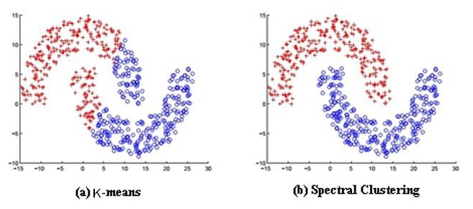
Spectral Clustering
This method basically uses the scope of similarity matrix of the data given so it can reduce its dimensionality which in turn reduces the number of clusters formed.
Figure 2: Spectral Clustering

Slide 8
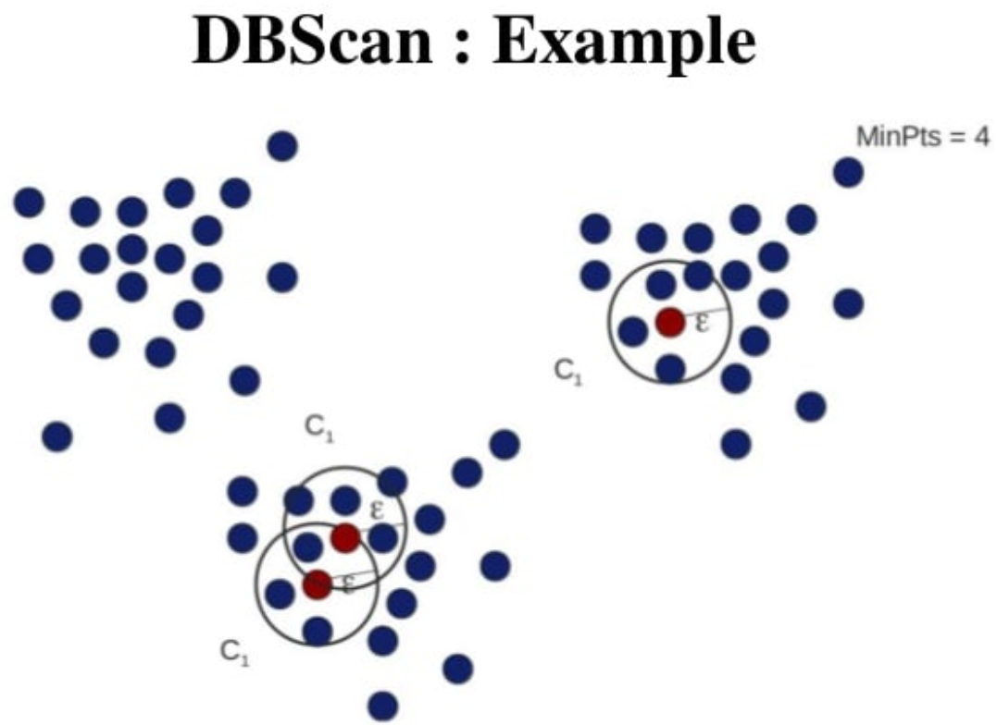
DBSCAN(Density-based spatial clustering of applications with noise)
The distance metric and criterion for a minimum number of data points are used by DBSCAN to group data points together. It requires two inputs: eps and minimum points. The Eps value indicates how near data points should be in order to be deemed neighbors. To consider the region as dense, the condition for minimum points should be completed.
Figure 3: DBSCAN Clustering

Slide 9
Competitors
KEEL(Knowledge extraction based on Evolutionary Learning)
mlpy
Weka

Slide 10
Risks
1)Attaining knowledge on the clustering techniques that we are going to use and tuning the algorithms to get optimal results.
2)Gain knowledge related to Simulink to be able to distinguish bad clusters from good clusters.
3)The need to depend on the project guide/mentor for reviewing the models, to get the accuracy of clusters obtained.
4)Providing the correct time for the deliverables.
5)Identifying the appropriate roles and assigning them to the respective teammate.
6)Too many anomalies or missing data in the dataset.

Slide 11
Features
1)One of the features of this project will be grouped/clustered Simulink project data. So that, when Simulink users need to refer to an existing project linked to a certain domain they can utilize it as a knowledge base for that particular domain.
2)Another use of this project can be to use a new simulink project metadata to figure out if that particular simulink project can be useful in a different domain other than the intended domain.

Slide 12
Customers / Users
The customers of our project will be organizations which use Simulink for their engineering designs.
The users of our project will be Engineers who use Simulink to implement designs and simulate their systems.

Slide 13
References
Figure 1: https://towardsai.net/p/machine-learning/k-means-clustering-from-scratch-2
Figure 2: https://towardsdatascience.com/unsupervised-machine-learning-spectral-clustering-algorithm-implemented-from-scratch-in-python-205c87271045
Figure 3: https://www.slideshare.net/MahbuburShimul/dbscan-algorithom
https://laptrinhx.com/partitional-clustering-1051791546/#:~:text=Partitional%20Clustering%20The%20most%20popular%20class%20of%20clustering,clusters%20until%20a%20%28locally%29%20optimal%20partition%20is%20attained

Slide 14
GitHub
https://github.com/Shiva-K-7/ASE-07

Slide 15
Thank You

